Slide 1

CSCI-3327 Project 1 Java Presentation
By: Ta’Quawn Watts

Slide 2
Overview of Java Project
StatsLibrary
A library of various functions used primarily in statistics
Person
Creates an object with a randomized birthday
BirthdayProgram
Determines the probability of any two people in a class with the same birthday
DoorGame
Determines the probabilities of the Monty Hall problem

Slide 3
StatsLibrary Methods
findMean()
Returns the mean of a list
findMedian()
Returns the median of a list
findMode()
Returns the mode of a list if there is one. Returns null if there is no mode or multiple modes
findStdDev()
Returns the standard deviation of a list

Slide 4
StatsLibrary Methods
findUnion()
Returns the union of subset A and subset B
findIntersection()
Returns the intersection of subset A and subset B
findComplement()
Returns the complement of a subset.

Slide 5
StatsLibrary Methods
factorial()
Returns the BigInteger factorial of an integer
solveCombo()
Returns the BigInteger combination of two integers
solveBinoDistrib()
Returns the BigDecimal Binomial Distribution
solveGeoDistrib()
Returns the BigDecimal Geometric Distribution

Slide 6
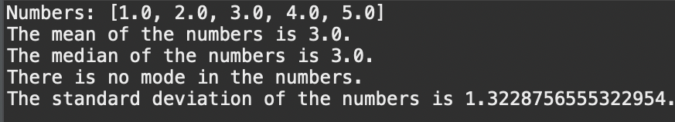
StatsLibrary Testing
TestStatsLibrary is the tester class for StatsLibrary.
TestStatsLibrary creates an ArrayList named “someNumbers” containing the elements (1.0, 2.0, 3.0, 4.0, 5.0) to test findMean, findMedian, findMode, and findStdDev methods. The output is:

Slide 7
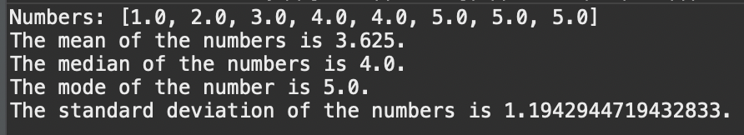
StatsLibrary Testing
If the someNumbers had contained a mode, it would output:

Slide 8
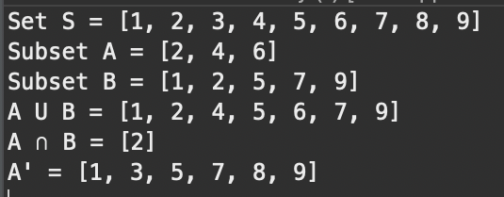
StatsLibrary Testing
To test findUnion, findIntersection, and findComplement, TestStatsLibrary creates three lists: set containing (1, 2, 3, 4, 5, 6, 7, 8, 9), listA containing (2, 4, 6), and listB containing (1, 2, 5, 7, 9).
It outputs:

Slide 9

StatsLibrary Testing
To test solveCombo and solvePerm, TestStatsLibrary uses the 10 and 4 as its integers. It outputs:

Slide 10
StatsLibrary Testing
To test solveBinoDistrib, TestStatsLibrary takes a problem from the Mathematical Statistics textbook.
To solve the problem, TestStatsLibrary calls solveBinoDistrib and subtracts its value from 1. It outputs:

Slide 11
StatsLibrary Testing
To test solveGeoDistrib, TestStatsLibrary uses an example from lecture. It outputs:

Slide 12

Person Object its Method
Person is an object. This object generates a birthday.
The only method in Person is the getter getBirthday() which returns the randomly generated birthday.

Slide 13
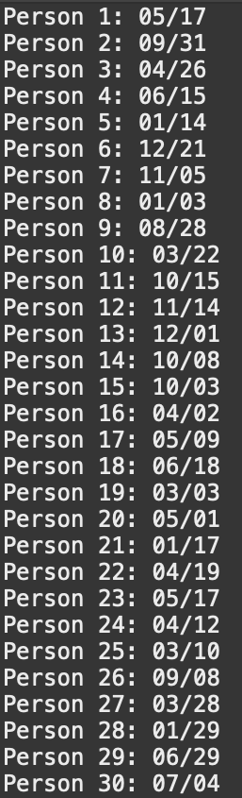
Person Testing
TestPerson is the tester class for Person. TestPerson creates 30 random Person objects and tests the getBirthday method. It outputs:

Slide 14
BirthdayProgram Methods
personGenerator
Returns a list of randomized birthdays
probCalculator
Returns the probability of two duplicate birthdays being generated

Slide 15
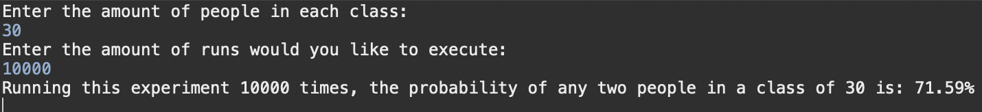
BirthdayProgram Testing
TestBirthdayProgram is the tester class for BirthdayProgram
TestBirthdayProgram asks the user to enter the amount of people in a class and the number of runs to execute. It outputs:

Slide 16
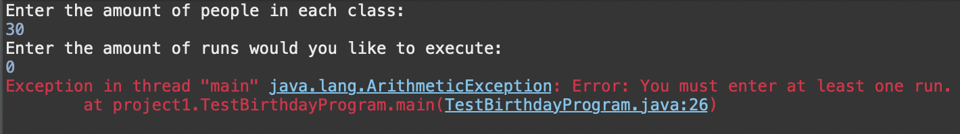
BirthdayProgram Testing
If the user inputs less than two people or less than one run, TestBirthdayProgram outputs the following errors:

Slide 17
DoorGame Methods
keepDoor
The probability of winning the "nice prize" if the contestant decides to keep their door.
changeDoor
The probability of winning the "nice prize" if the contestant decides to change their door.

Slide 18
DoorGame Testing
TestDoorGame is the tester for DoorGame. Using four lines of code, it outputs:

Slide 19
Difficulties throughout Project 1
“Relearning” Java
I transferred from Rutgers Camden and their Computer Science program focused primarily on Python. While I did take a couple courses at Stockton University that focused on Java, I still had to “relearn” the basics.
Very small numbers and BigDecimal
I could not figure out, when using solveBinoDistrib and solveGeoDistrib, why I kept getting weird “numbers”. I realized that double type was unable to properly represent the very small numbers and to use BigDecimal. It was confusing at first, but I got it eventually.
Overcomplicating the DoorGame class
At first, I began coding the Monty Hall problem as I read it. I created a list of prizes, randomly picked one, and removed a door (making sure it was not the door that either had the prize or was the door that was randomly picked). It started to confuse me and I worried I would not be able to do it. That is when I realized a simple fact; if it picked a dud and switched their answer, it will always be a prize. After that clicked, I was able to complete the program in no time.

Slide 20
Learning Outcomes
Learning Javadocs
I wanted this project to be as professional as possible. This project taught me how to create professional styled Javadocs and their importance
Familiarity with GitHub
I created my GitHub for a project last semester and I still had no clue how it worked. I learned how to directly commit and push from my IDE, create a professional looking GitHub repository, and how exactly the GitHub workflow works.
Familiarity with programming in Java
This project has given more time with Java than I ever had. This is my biggest project in Java and it has helped me feel more comfortable programming in Java.

Slide 21
Sources
https://stackoverflow.com/questions/62438100/string-decimal-to-percentage-in-java
https://stackoverflow.com/questions/363681/how-do-i-generate-random-integers-within-a-specific-range-in-java
https://www.geeksforgeeks.org/switch-statement-in-java
https://www.tutorialspoint.com/java-program-to-add-leading-zeros-to-a-number
https://www.baeldung.com/java-copy-list-to-another
https://www.javatpoint.com/factorial-program-in-java
https://www.geeksforgeeks.org/biginteger-class-in-java/
https://stackoverflow.com/questions/6219692/very-small-numbers
https://stackoverflow.com/questions/3115413/how-to-convert-biginteger-to-bigdecimal"
https://www.geeksforgeeks.org/throw-throws-java/
https://howtodoinjava.com/java/collections/arraylist/add-multiple-elements-arraylist/

